Slide 1


Slide 2


TFS Sensor head enclosure Development of robust and cost-effective sensor head enclosure for sheet gauging system with high thermal stability
Author: Sioux Technologies

Slide 3
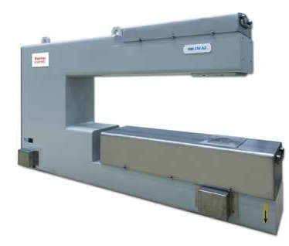
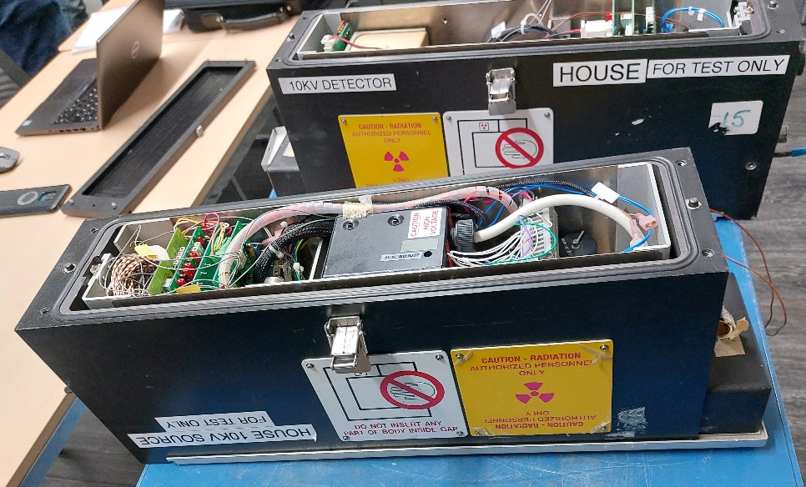
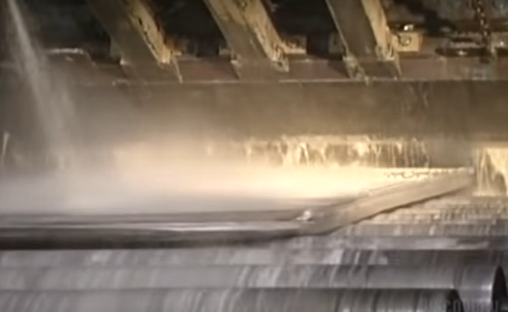
Modular Sensor Head Enclosure for TFS Xray Thickness Gauges enabling 2nd source x-ray suppliers
Sensor head enclosure:
Used in aluminium rolling industry
Challenging environment: kerosine, temperatures, fires, collisions.
Thickness measurement 5-700 [micron]
X-ray source: 10 kV
Robust enclosers for source and detector.
Thermal stability
Modular design for serviceability
Enables 2nd source x-ray supplier
Context and history in general;
Aluminium foil market is expected to boom in next 3-5 years.
TFS has no product for this market in its portfolio
Delivery issues with current x-ray source supplier
Sioux is already making electronics / software for TFS
DETECTOR
DETECTOR
SOURCE
SOURCE
Notes:
Project Name
Summary of the project definition (in phrase not a sentence)
Project characteristics in bullets, i.e.
Software, system development, etc.
Automotive, medical, etc.
Context and history in general;
What are the business drivers
What initiates this project
Why customer has chosen Sioux
What makes Sioux unique
Why the customer needs this project

Slide 4
Project Goal, Scope, and Impact
DETECTOR
ENCLOSURE
Is:
Engineering project to design a frame and enclosure flat sheet gauging system
The design should be:
Thermally stable
Mechanically robust
Modular for serviceability
Easy to assemble
Cost effective
Enable second source x-ray supplier
MOUNTING INTERFACE
CONNECTOR
E-BOX
X-RAY SENSOR
COOLING
TEMP
ALUMINIUM
X-RAY
COOLING
BEAM CONTROL
TEMP
STABILITY MEASUREMENT
Is-not:
Only engineering project. Production out of scope. Except for 3 protos.
Is not system engineering. Key components out of scope: x-ray source, detector, beam control components. Mostly mechanical.
CONNECTOR
MOUNTING INTERFACE
EMITTER
ENCLOSURE
SOURCE
Notes:
Is:
Technical project definition
Goals to achieve
In scope aspects / functions
Is-not:
Out of scope aspects /functions that can lead misunderstanding
Already present aspects/ functions

Slide 5
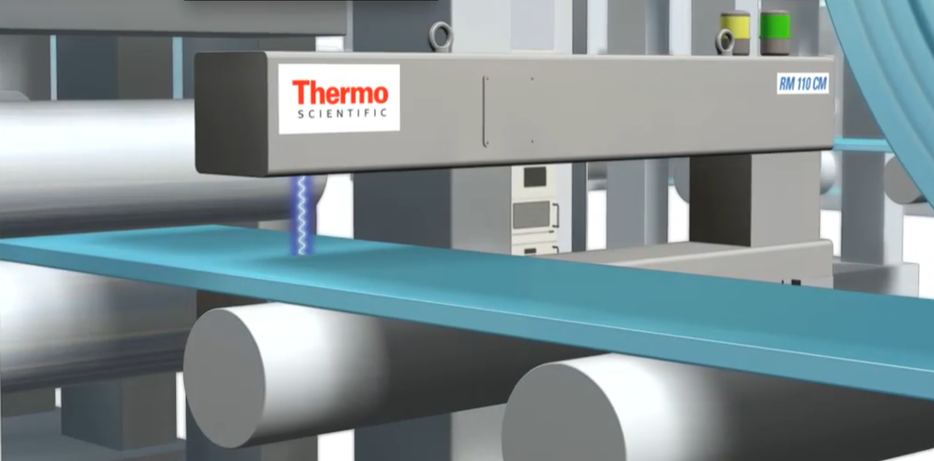
Project Goal, Scope, and Impact
Goal and customer business case:
Within their flat sheet gauging solutions TFS is looking to improve their position in the aluminium foil market.
A solution existed in their portfolio but is considered obsolete.
The overall project seeks out to develop a new solution for the aluminium foil market.
Objective USPs: superior thermal stability and optimal serviceability.
TFS plans to build 25-50 systems / year.
Cost target source part 12k EURO.
Delivery of 3 protos. At least 1 end 2023.
FUMO foreseen for lifetime testing.
Notes:
Goal and customer business case:
Market needs, market competitions, project context, customer’s business case, customer objectives
Number of planned FuMo, alpha, beta versions (like 3 FuMo in a year, 20-25 systems/year etc.)
Etc.

Slide 6
Business Decomposition Overview
High level overview of work packages with external stakeholders including the company names and high level roles,
i.e. which party is responsible for what
Use of different colors for different parties is recommended.
Use of orange is recommended for Sioux.
Thermo Fisher Scientific
Sioux Eindhoven [Mechanical Design / Thermal Analysis]
Sioux Erlangen (Germany)
[Electronics Development]
SmartArt Design Tab can be used to change the diagram
Notes:
High level overview of work packages with external stakeholders including customer roles
i.e. which party is responsible for what
Use of different colors for different parties is recommended.
Use of orange is recommended for Sioux.
SmartArt Design Tab can be used to change the diagram

Slide 7
Engineering Decomposition
TFS Sensor head
[S-WP]
[S-WP1]
[S-WP3]
[S-WP2]
[S-WP3.1]
[P2-WP]
[S-WP3.2]
[O-WP]
More detailed view to Sioux’s work packages [S-WP] including out-sourced [O-WP] work packages and the external work packages (like work packages for customer or other parties, partners [P-WP], etc.)
End-users can be included if applicable.
Use of different colors for different parties is recommended. Keep the same color convention through the presentation.
Planned meetings including the informative names (steering, technical discussion etc.) and frequencies (one a week etc.)
SmartArt Design Tab can be used to change the diagram
Notes:
More detailed view to Sioux’s work packages (S) including out-sourced (O) work packages and the external work packages (like work packages for customer or other parties, partners (P), etc.)
End-users can be included if applicable.
Use of different colors for different parties is recommended. Keep the same color convention through the presentation.
Planned meetings including the informative names (steering, technical discussion etc.) and frequencies (one a week etc.)
SmartArt Design Tab can be used to change the diagram

Slide 8
Modular Sensor Head Enclosure Structural Decomposition Overview
DETECTOR
E
Source
Outer enclosure
Cooling
Stability measurement module
Ionization chamber
Emitter module
Electronics
HV supply
Source
Shutter
Beam control module
Collimator
Pre-filter
Sample holder
External temperature sensor enclosure
Temperature sensor
Aluminum exit window
Detector
Outer enclosure
Cooling
E-box
Electronics
Sensor
Ionization chamber
External temperature sensor enclosure
Temperature sensor
Aluminum entrance window
D
F
C
G
B
H
A
I
16
X-RAY
15
1
14
2
13
3
12
4
11
5
10
6
7
8
9
SOURCE

Slide 9
Work Breakdown
Summary of content and goal of each Sioux work package present in Engineering Decomposition, i.e.;
[S-WP1]: …
[S-WP2]: …
Notes:
Summary of content and goal of each Sioux work package present in Engineering Decomposition, i.e.;
[S-WP1]: …
[S-WP2]: …

Slide 10
Estimation on Engineering Decomposition
Notes:
Month can be quarter depending on the time-line of the project
Tips to edit:
1- Double click on a cell to open and edit the embedded Excel sheet
2- Right click→ Worksheet Object → Open to open the Excel program separately
3- Cells to be displayed: Click object once and adjust

Slide 11
Functional Decomposition
Sioux related work packages focusing on functional distribution
Independent functions can have their own diagrams not attached to a higher hierarchy
Use of the same color for Sioux.
[Text]
SmartArt Design Tab can be used to change the diagram
Notes:
Sioux related work packages focusing on functional distribution
Independent functions can have their own diagrams not attached to a higher hierarchy
Use of the same color for Sioux.
SmartArt Design Tab can be used to change the diagram

Slide 12
Estimate Cost of Goods
Per FuMo, per device, per work package and eventually total cost
Preferably including test set-ups, tools etc.
Preferably including costs other than Engineering Decomposition like clear estimates defining packaging, assembly hours, etc.
Just the “total estimation” can be mentioned if more detail is not available for the time being.
Notes:
Per FuMo, per device, per work package and eventually total cost
Preferably including test set-ups, tools etc.
Preferably including costs other than Engineering Decomposition like clear estimates defining packaging, assembly hours, etc.
Just the “total estimation” can be mentioned if more detail is not available for the time being.

Slide 13

Project Decomposition Overview
[Project Manager]
[System Architect]
[Core Team Member / Discipline Architect]
[Account Manager]
[Core Team Member / Discipline Architect]
[Core Team Member / Discipline Architect]
[Core Team Member / Discipline Architect]
[Core Team Member / Discipline Architect]
SmartArt Design Tab can be used to change the diagram
Internal Stakeholders, i.e. 3 in a box (3IAB): project manager, system architect, account manager and other core members like: internal work package owners, discipline architects, team leads, core team members, consultants, STA etc.
Preferably with names and roles; if not certain yet, then only roles per discipline. Sharing the pictures of the (known) team members is also recommended.
Different colors can be used per discipline.
Planned meetings including the informative names (architecting, technical discussion etc.) and frequencies (one a week etc.) can also be shared.
Notes:
Internal Stakeholders, i.e. 3 in a box (3IAB): project manager, system architect, account manager and other core members like: internal work package owners, discipline architects, team leads, core team members, consultants, STA etc.
Preferably with names and roles; if not certain yet, then only roles per discipline. Sharing the pictures of the (known) team members is also recommended.
Different colors can be used per discipline.
Planned meetings including the informative names (architecting, technical discussion etc.) and frequencies (one a week etc.) can also be shared.
SmartArt Design Tab can be used to change the diagram

Slide 14
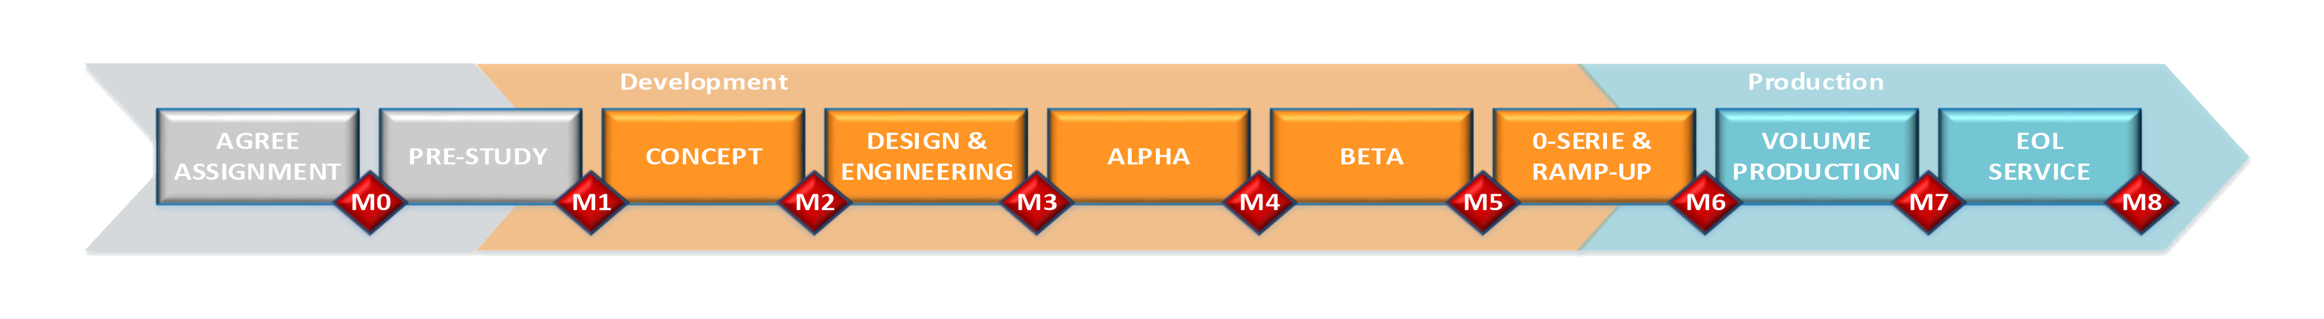
Milestones and Key Deliverables
Notes:
Dates can be TBD or an interval if not certain
Preferable in align with Sioux QMS otherwise necessary milestones according to the customer demands
Tips to edit:
1- Double click to open and edit the embedded Excel sheet
2- Right click→ Worksheet Object → Open to open the Excel program separately
3- Double click to adjust the cells to be displayed

Slide 15
Visual Time Line Planning
A Microsoft Project or Excel planning screenshot for general timeline indication or the document itself for detailed view
If the Milestones and Key Deliverables Slide explains enough, this slide can be skipped.
Notes:
A Microsoft Project or Excel planning screenshot for general timeline indication or the document itself for detailed view
If the Milestones and Key Deliverables Slide explains enough, this slide can be skipped.
Tips to edit:
1- Double click to open and edit the embedded Excel sheet
2- Right click→ Worksheet Object → Open to open the Excel program separately
3- Double click to adjust the cells to be displayed

Slide 16
Estimation on Staffing
Departments and Competences can be chosen from the cell by using the pull-down menu
Note that the competences are copied from Competence Groups - Home (sharepoint.com) in 25/03/2022, it may need an update.
Can be converted to project dashboard (SHA.PJM.TPL-17) once enough details are present.
Purchaser, regulation consultancy can also be added.
Notes:
Month can be quarter depending on the time-line of the project
Departments and Competences can be chosen from the cell by using the pull-down menu
Note that the competences are copied from Competence Groups - Home (sharepoint.com) in 25/03/2022, it may need an update.
Can be converted to project dashboard (SHA.PJM.TPL-17) once enough details are present.
Purchaser, regulation consultancy can also be added.
Tips to edit:
1- Double click to open and edit the embedded Excel sheet
2- Right click→ Worksheet Object → Open to open the Excel program separately
3- Double click to adjust the cells to be displayed
4- Departments and Competences can be chosen from the cell by using the pull-down menu
Note that the competences are copied from Competence Groups - Home (sharepoint.com) in 25/03/2022, it may need an update.

Slide 17
Regulatory Demands
Automotive regulations, medical device regulations (like IVDR, CGMP etc), Applicable international or European Standards (ISOxxxx, etc), internal quality assurance standards (QMS), etc.
Notes:
Automotive regulations, medical device regulations (like IVDR, CGMP etc), Applicable international or European Standards (ISOxxxx, etc), internal quality assurance standards (QMS), etc.

Slide 18
Project Assumptions / Risks / Potential Mitigations
Risks foreseen up-front and mitigation methods if applicable together with project assumptions (if applicable)
The category list is aligned with the Quotation Guide Card (SHA.SAL.TPL-23, 12 Mar 2021, v04)
Notes:
Risks foreseen up-front and mitigation methods if applicable together with project assumptions (if applicable)
The category list is aligned with the Quotation Guide Card (SHA.SAL.TPL-23, 12 Mar 2021, v04)
Tips to edit:
1- Double click on a cell to open and edit the embedded Excel sheet
2- Right click→ Worksheet Object → Open to open the Excel program separately
3- Cells to be displayed: Click object once and adjust

Slide 19
Contacts for 3IAB
Project Manager:
System Architect:
Account Manager:
Notes:
Contact info including phone number and email address.

Slide 20
Source of your technology

